Slide 1
Advanced Apex Project I
Team Members:
1. Aswin Kumar K S
2. Magdalene Sunitha

Slide 2

Clustering Biological Specimens Using Morphological Features
This project applies an end-to-end unsupervised learning pipeline to the Dry Bean dataset.
Using structured numerical shape and size features, the objective is to identify natural clusters representing different bean types
.
The solution includes data cleaning, feature engineering, correlation-based feature reduction, optimal-k selection, and K-Means clustering.
Inference and evaluation are performed on production data to validate cluster stability.
The project aims to create a reproducible clustering pipeline that generalizes well to new data that supports faster, scalable, and objective bean classification—reducing manual effort and enabling better decisions for research and agriculture.

Slide 3
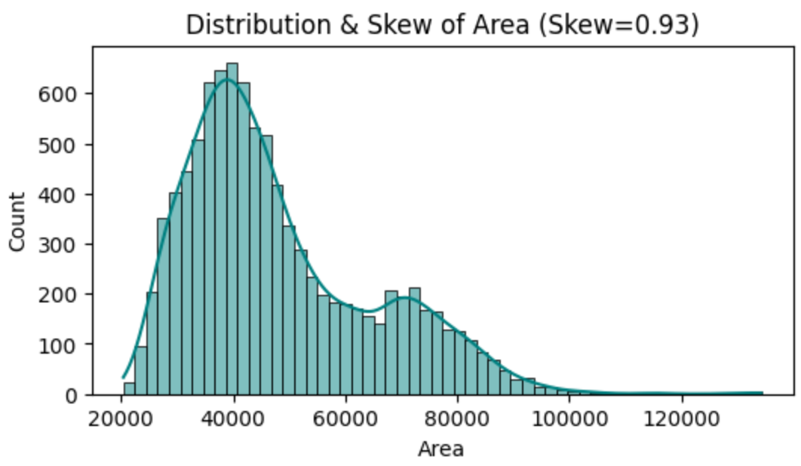
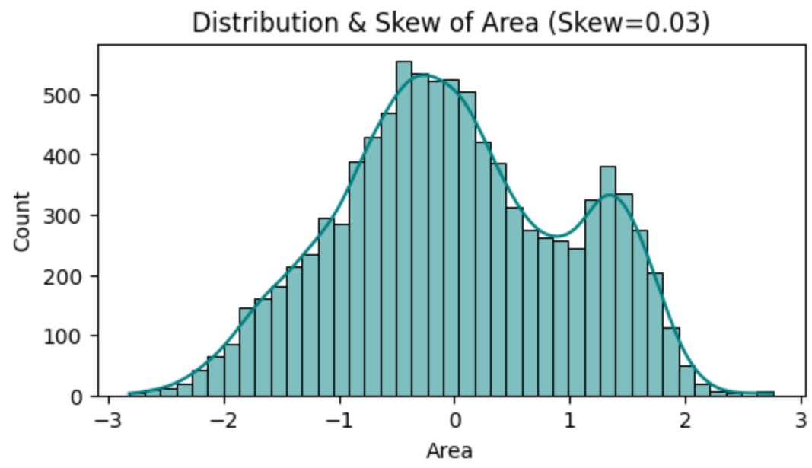
Key Observations - Before vs After Feature Transformation
Before Feature Transformation
Before Feature Transformation:
The Area feature shows strong right-skew, meaning many beans have small areas while fewer have very large areas.
The distribution is highly uneven, dominated by lower-value ranges and a long tail toward large values.
Such skewness distorts distance-based clustering (like K-Means), causing larger values to dominate.
After Feature Transformation:
The distribution becomes nearly symmetric, with skew reduced from 0.93 → 0.03.
The transformed feature shows more balanced spread, making patterns easier for K-Means to learn.
This confirms that PowerTransformer successfully corrected skewness, improving cluster stability and fairness across features.
After Feature Transformation

Slide 4
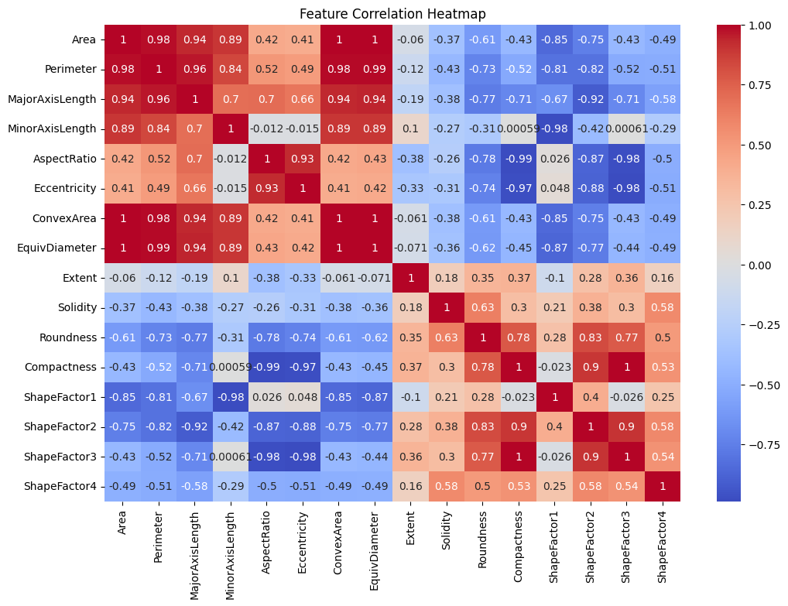
Key Observations - Feature Correlation
Size features (Area, Perimeter, Axis Lengths, ConvexArea, EquivDiameter) are highly correlated → they all measure bean size.
Shape features (AspectRatio, Eccentricity, Roundness, Compactness, ShapeFactors) form another strongly correlated group.
Some features show strong inverse relationships (e.g., Roundness vs AspectRatio)..

Slide 5
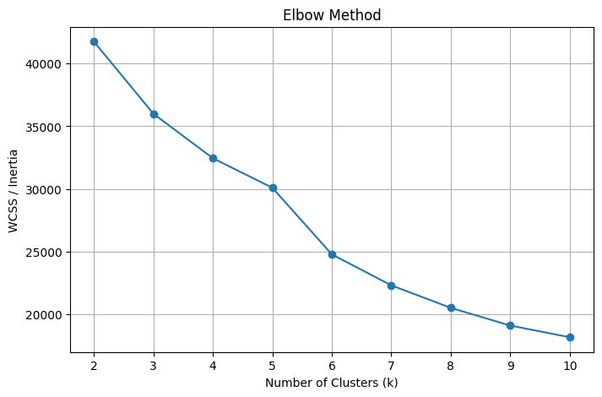
Visual Highlights - Optimal Cluster Count (Elbow Method)
The Elbow Method shows that at k = 7, the decrease in inertia becomes noticeably smaller, indicating diminishing returns beyond this point
Silhouette behavior (Score=0.2506) also remains stable around k = 7, supporting this choice.
k = 7 balances compactness and separation of clusters effectively.
This value ensures meaningful segmentation without overfitting or unnecessary complexity.

Slide 6
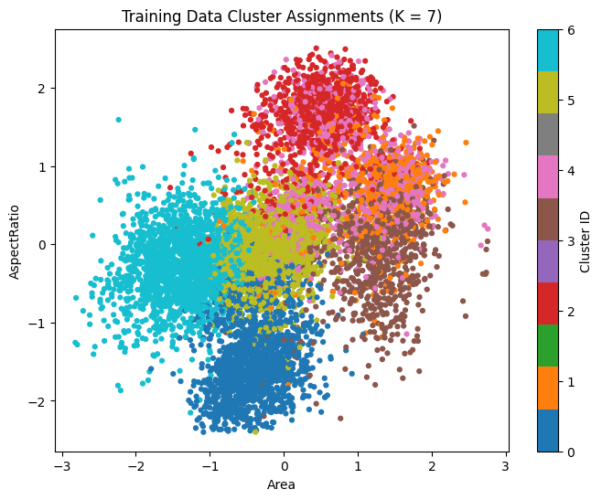
Visual Highlights - Training Data Cluster Behavior
Training data reveals well-defined clusters with minimal overlap in key feature space.
Indicates strong underlying structure in bean morphology features.
Confirms that preprocessing (PowerTransformer + StandardScaler) improved cluster stability due to which clear separation and consistent shapes.
Figure represents the model’s ability to discover natural groupings in the dataset.

Slide 7
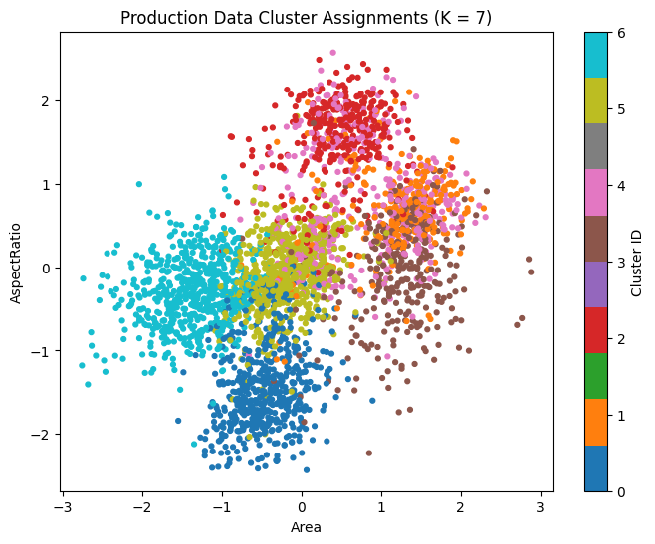
Visual Highlights - Production Data Cluster Behavior
Production clusters closely mirror the structure of training clusters.
Shows good model generalization with no major deviations in distribution.
No visible signs of data drift across size or shape-related features.
Confirms that the trained model remains reliable for unseen real-world data.
Stable clustering patterns support deployment and scalability of the pipeline.

Slide 8
Clustering Quality Metrics
Silhouette Score (Training): 0.25 | Score confirms that the 7-cluster solution is valid but the dataset has natural similarity between bean types, so boundaries are not completely sharp.
Davies–Bouldin Index (Training): 1.319 | Shows moderately good cluster compactness and separation. A DBI around 1.0–1.5 is generally acceptable in practical/industrial clustering use-cases, especially for real-world biological or morphological datasets where natural overlap is expected.
Davies–Bouldin Index (Inference): 1.298 | Slightly better than training, meaning production data fits the learned cluster structure well.
Very small DBI difference (≈0.02) | Indicates no data drift, and the model generalizes smoothly from training to production.

Slide 9
Conclusion
Successfully developed an end-to-end, production-ready clustering pipeline combining robust preprocessing, feature engineering, dimensionality reduction, and K-Means modeling.
Identified 7 optimal clusters through a combination of Elbow and Silhouette analysis, ensuring a balance between cluster compactness and separation.
The final model demonstrated stable and meaningful cluster boundaries, supported by scatterplot visualizations and Davies–Bouldin scores.
Production (inference) results aligned closely with training behavior, confirming strong generalization and no significant data drift.
Overall, the project achieved its goal of automatically discovering natural bean groups, enabling scalable, objective, and reproducible morphological classification.

